Slide 1
Computer Architecture
Week 3

Slide 2
Objectives
Representing negative numbers using two’s complement
Computer components as building blocks
Subtraction based on addition
Bit shifter
To introduce the concept of an ALU

Slide 3
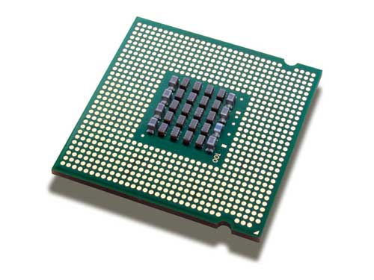
Computer Components
CPU: Central Processing Unit
The part of the computer that carries out instructions
Different makes of CPU will have different instructions they can do
Considered to contain
ALU: arithmetic/logic unit
Control unit

Slide 4
ALU
Different computer processor families will have different operations available and could include:
Arithmetic operations (add, subtract, multiply)
Bitwise AND, OR, NOT etc
Shift all the bits in an input
Compare inputs

Slide 5


Joining Instructions
Join at vevox.app
ID: 165-289-715
Or search Vevox in the app store

Slide 6
What is the result of a bitwise AND between 1001 and 1110?
Join: vevox.app ID: 165-289-715
Enter Text and Press Send
The correct answer is
1000
79.03% of participants answered correctly
Vote Trigger

Slide 7
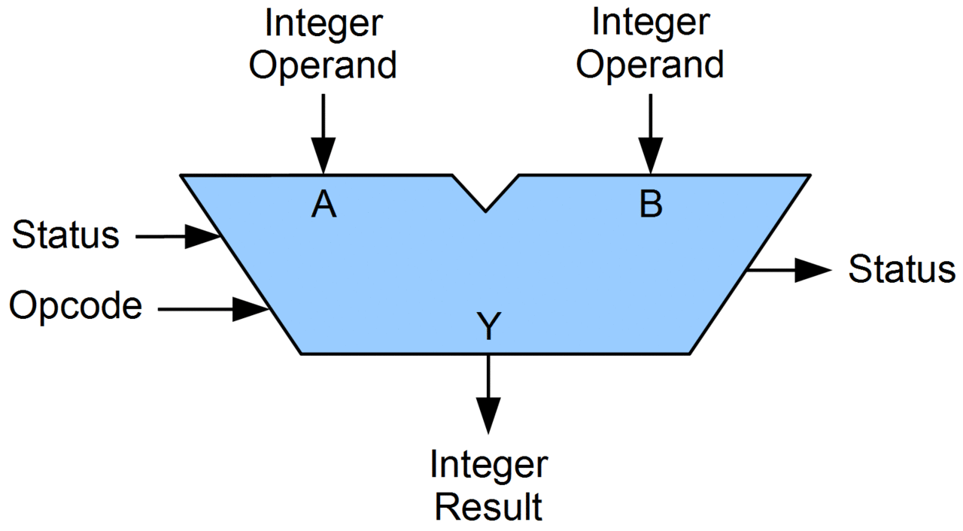
ALU: common features
The ALU takes two operands (A and B)
Binary signals to carry out an operation on
There is an input Opcode
A code for which operation is needed
The output is the result of carrying out the required operation on A and B
There may be output status / condition code indicators
Often all the available instructions will be done at the same time (in parallel) and the relevant result selected to pass to the output
Image credit: By Lambtron - Own work, CC BY-SA 4.0,
https://commons.wikimedia.org/w/index.php?curid=36975996

Slide 8
What component can we use to select one from a number of inputs?
Join: vevox.app ID: 165-289-715
POLL OPEN
1
Decoder
5.81%
ü
2
Multiplexer
81.4%
3
Comparator
11.63%
4
Ripple-carry adder
1.16%
Vote Trigger

Slide 9
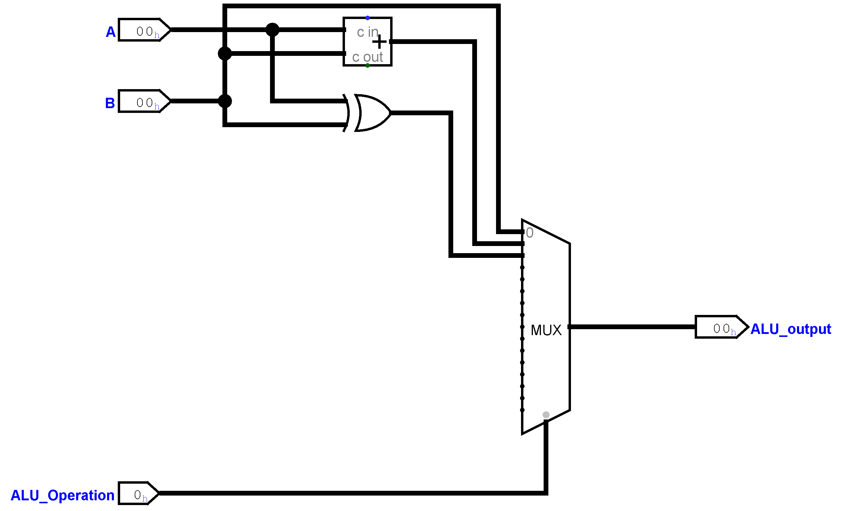
ALU from last year’s coursework
Pins show hexadecimal values
One task was to amend the ALU so that operation 3 multiplies the two inputs.

Slide 10
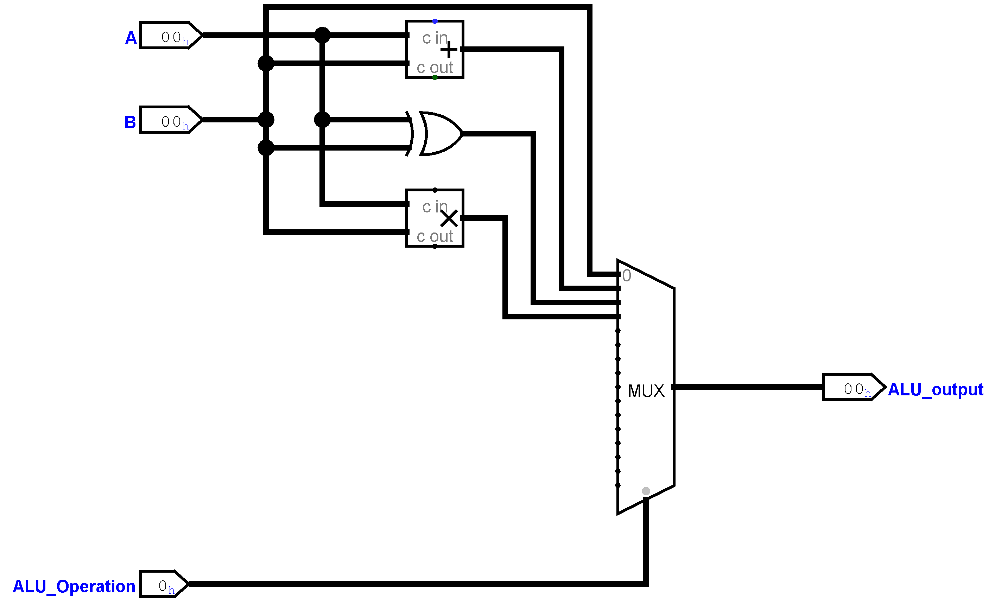
Amended ALU from last year’s coursework

Slide 11
Performance considerations
What a computer can do depends on hardware and software combined
How many functions should an ALU have?
For example, you can code multiplication as repeated addition so don’t need to include multiplication in an ALU
Putting multiplication in the ALU would make it more complex and expensive to create the hardware, but programs that need a lot of multiplication would run faster.

Slide 12
Binary numbers
We have seen how to represent positive integers in binary format
For example, binary 1100110
In decimal is 64 + 32 + 4 + 2 = 102
128 | 64 | 32 | 16 | 8 | 4 | 2 | 1
0 | 1 | 1 | 0 | 0 | 1 | 1 | 0

Slide 13
Representing negative numbers
There are several different ways that have been proposed to represent negative numbers, we will cover the one that is almost universal in modern computers, two’s complement
If we just had one bit for the sign (+ or -)
We would end up with two different representations of zero
We would need more complex circuits for addition
Using two’s complement
Addition works as you would expect for positive and negative numbers

Slide 14
What do you get if you do a bitwise NOT operation on 00001101?
Join: vevox.app ID: 165-289-715
Enter Text and Press Send
The correct answer is
11110010
94.29% of participants answered correctly
Vote Trigger

Slide 15
Binary addition
Adding 1
00010101
+ 00000001
==========
00010110

Slide 16
What do we get if we add 1 to the binary number 0100?
Join: vevox.app ID: 165-289-715
Enter Text and Press Send
Give your answer as four bits
The correct answer is
0101
85.9% of participants answered correctly
Vote Trigger

Slide 17
Two’s complement
To get the two’s complement of a binary number
Invert each of the bits
Add 1 to the result (binary addition)

Slide 18
What is the 8-bit two’s complement of the binary number 00011011?
Join: vevox.app ID: 165-289-715
Enter Text and Press Send
To get the two’s complement of a binary number
Invert each of the bits
Add 1 to the result
Give an 8-bit answer
The correct answer is
11100101
88.31% of participants answered correctly
Vote Trigger

Slide 19
Two’s complement to represent negatives
To express a decimal value in two’s complement binary:
If the number is positive (or zero)
Convert it to binary in the normal way
There needs to be at least one leading zero
If the number is negative:
Work out the binary of the positive value
Take the two’s complement of that binary number

Slide 20
Two’s complement
The number of bits being used for the representation is important
When the most significant bit is one, the number is negative
11101010 is negative
01101101 is positive
For 8-bit representation, two’s complement is equivalent to using the column headings
-128 | 64 | 32 | 16 | 8 | 4 | 2 | 1
0 | 1 | 1 | 0 | 0 | 1 | 1 | 0

Slide 21
Which of the following 8-bit two’s complement numbers are negative?
Join: vevox.app ID: 165-289-715
POLL OPEN
Vote for up to 2 choices
1
00101011
2.74%
ü
2
10110010
87.67%
3
00011111
4.11%
ü
4
10001001
95.89%
(% = Percentage of Voters)
You do not need to convert the numbers to decimal for this task.
Vote Trigger

Slide 22
Two’s complement example
To get the binary for -27 in 8-bit two’s complement
Work out the binary for +27
Invert all the bits
Add 1 to give the representation for -27
00011011
11100100
11100101

Slide 23
Two’s complement exercise
To get the binary for -5 in 8-bit two’s complement
Work out the binary for +5
Take the two’s complement
00000101

Slide 24
What is the 8-bit two’s complement of the binary number 00000101?
Join: vevox.app ID: 165-289-715
Enter Text and Press Send
Give an 8-bit answer
To get the two’s complement of a binary number
Invert each of the bits
Add 1 to the result
The correct answer is
11111011
81.82% of participants answered correctly
Vote Trigger

Slide 25
Two’s complement exercise
To get the binary for -5 in 8-bit two’s complement
Work out the binary for +5
Invert all the bits
Add 1 to give the representation for -5
00000101
11111010
11111011

Slide 26
Two’s complement – binary to decimal
To get the decimal equivalent of 11110010 which represents a number in 8-bit two’s complement
The most significant bit is a 1, so we know it’s a negative number
Take the two’s complement then convert to decimal and add a minus sign
Flip all bits
Add 1
Convert 1110 to decimal
Is 8 + 4 + 2
gives 14
The original number 11110010 was -14
00001101
00001110

Slide 27
Two’s complement – binary to decimal – alternative approach
To get the decimal equivalent of 11110010 which represents a number in 8-bit two’s complement
Alternative approach – change the column heading for the rightmost bit to be negative
Convert to decimal as normal by adding up the column headings where a 1 appears
-128 + 64 + 32 +16 + 2
The original number 11110010 was -14
-128 | 64 | 32 | 16 | 8 | 4 | 2 | 1
1 | 1 | 1 | 1 | 0 | 0 | 1 | 0

Slide 28
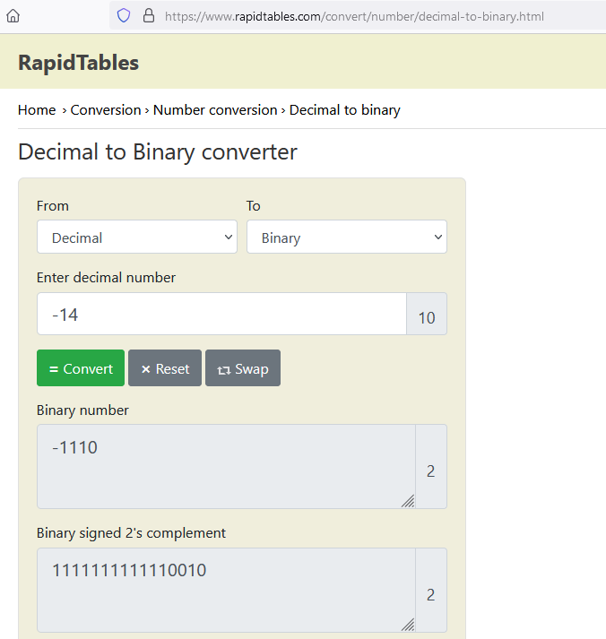
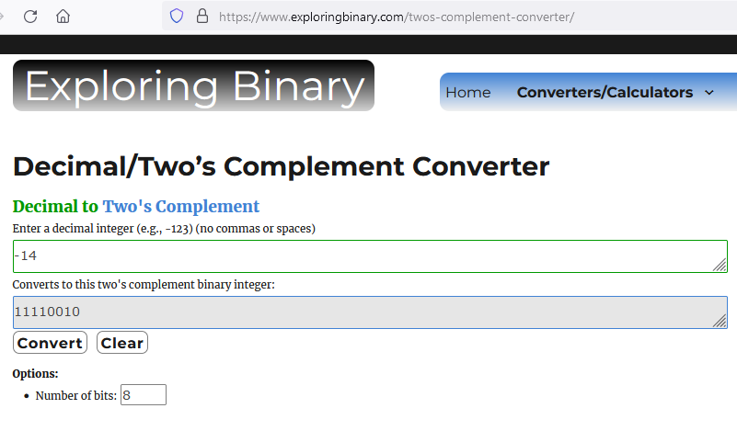
Using online tools
For this unit, you need to be aware of two’s complement but can use any online tools to do the conversion

Slide 29
Two’s complement - range
Using 4-bit representation
All possible binary values are 0000 … 1111
Remember that gives us 16 different values
All numbers starting with 1 are negative
All the positive numbers we can make are
000 to 111 (that is 0 to 7 in decimal)
All the negative numbers we can make are
1000 to 1111 (-8 to -1 respectively in decimal)
We have 16 different values from decimal -8 to +7
Note that if we add 1 to 111 (decimal 7) we get 1000 (decimal -8)

Slide 30
Subtraction by adding a negative
Suppose we want to work out the decimal calculation 48 - 19
We can treat it as 48 + (-19)
We have seen that we can create a component for addition and can use a gate to invert a value
This might be easier or cheaper than building a separate component for subtraction

Slide 31
Subtraction by adding a negative: 48 + (-19)
Using 8-bit two’s complement
48 is binary 00110000
+19 is binary 00010011
Two’s complement of 00010011
Invert gives 11101100
Add 1 11101101
Add the two numbers and ignore the overflow:
00110000
11101101 +
---------
00011101
Convert back to decimal to check
Binary 11101 is decimal 29

Slide 32
Summary
The ALU is a component that can carry out multiple operations on two inputs. The opcode determines which result will be output.
Two’s complement is the most common way to represent negative numbers in binary
In next week’s lab
We will look at further components – decoder and bit shifter
We will build an ALU in Logisim Evolution

